Slide 1
Bioaccumulation Dynamics
Penobscot Estuary Community Modeling Workshop
ABM Draft Bioaccumulation Function
August 6th, 2025
Drafted By: Vanessa Quintana

Slide 2
Relevant Background Information
Term | Definition
Contamination | Harmful substances (like mercury and methylmercury) that can be found in the environment and affect fish health.
Suspended Particulate Matter (SPM) | Tiny floating particles in the water that can carry pollution and be absorbed through skin and gills exposure.
Stress | The strain a fish feels when something in the environment changes (like temperature, or salinity) that makes it harder for them to stay healthy.
Bioaccumulation | The buildup of harmful chemicals (like mercury and methylmercury) inside a fish over time, leading to fish toxicity.

Slide 3
Model Objectives
Purpose: Simulates exposure to contamination as fish move through the system
Objectives:
Simulate exposure dynamics Track how migratory fish encounter and accumulate mercury (Hg) and methylmercury (MeHg) across space and time.
Capture thresholds and exceedance Identify when exposure exceeds health thresholds that may trigger physiological stress or regulatory concern.
Quantify Bioaccumulation Risk Compute cumulative exposure and uptake risk by integrating environmental contamination, stress responses, and suspended particulate matter dynamics.

Slide 4
Key Variables for the Model
🌍 Environmental Variables
🐟 Individual (Fish) Variables
🧪 Mercury (Hg) The concentration of inorganic mercury in the water or on particles.
☠️ Methylmercury (MeHg) The toxic organic form of mercury that bioaccumulates in fish tissue.
🌫️ Suspended Particulate Matter (SPM) The amount of fine material suspended in the water column.
📍 Time Spent The total time a fish spends in one location.
⏱️ Patch Exposure Time How long a fish stays in a contaminated area.
⚠️ Patch Risk How likely a fish is to absorb mercury in a specific area.
🧠 Stress The level of stress an agent experiences at the current time step.
🌫️ Exposure The amount of Hg and MeHg an agent is exposed to in the current time step.
📊 Exposure Total The total amount of Hg and MeHg fish are exposed to throughout their migration.
⏱️ Exposure Duration The amount of time an agent is exposed to Hg or MeHg above healthy levels throughout their migration.
⚠️ Uptake Risk The level of risk associated with uptake of Hg and MeHg from SPM at the current time step.

Slide 5
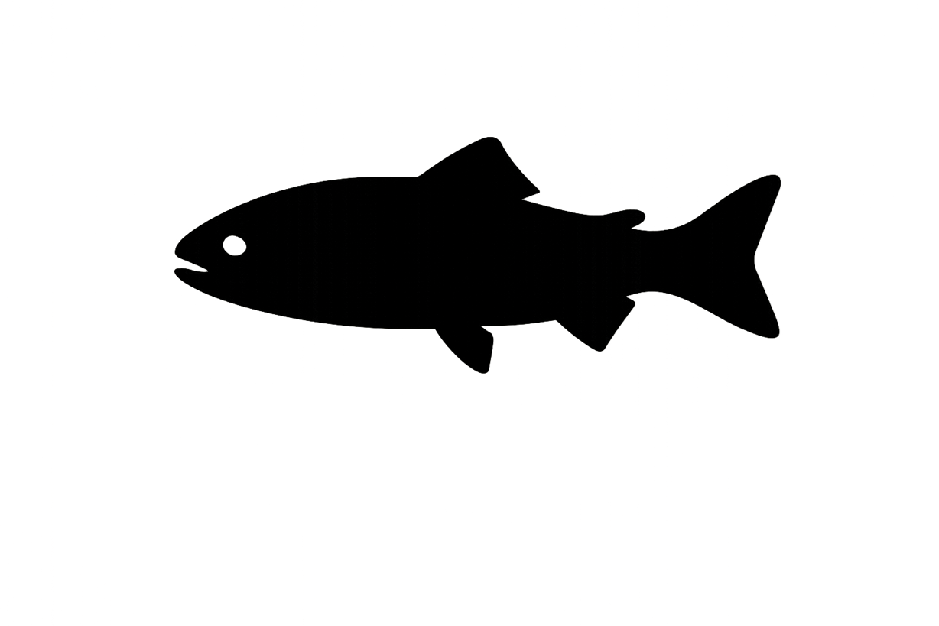
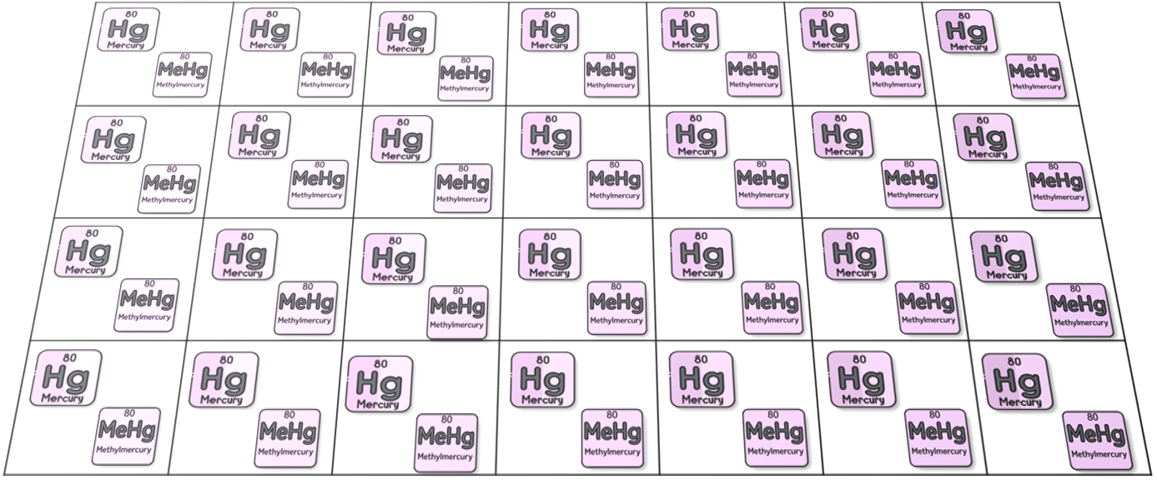
1. Fish Interact with Environmental Contamination
Environmental Contamination
(Mercury or Methylmercury)
Fish Encounter Varying Levels of Contamination Throughout their Environment

Slide 6
2. Track Time Fish Spends in Each Patch
Environmental Contamination
(Mercury or Methylmercury)
Time-Spent = Time-Spent + 1

Slide 7
2. Track How Much Contamination Fish Encounter
Environmental Contamination
Hg-Exposure = Mercury Concentration in Patch
MeHg-Exposure = Methylmercury Concentration in Patch
Notes:
Where exposure captures temporal changes in exposure to contamination throughout the migrations.

Slide 8
3. Track How Much Total Contamination Fish Encounter
Environmental Contamination
Hg-Exposure-Total = Hg-Exposure-Total + Hg-Exposure
MeHg-Exposure-Total = Hg-Exposure-Total + Hg-Exposure
Notes:
Where exposure captures temporal changes in exposure to contamination throughout the migrations.

Slide 9
4. Determine if Contamination Exceeds Recommended Health Threshold for Fish Exposure
Environmental Contamination
If Hg-Exposure > 15 ug/kg Hg-Exposure-Duration = Hg-Exposure-Duration + 1
If MeHg-Exposure > 150 ug/kg MeHg-Exposure-Duration = MeHg-Exposure-Duration + 1
Notes:
Where Exposure duration quantifies the amount of time fish spend in areas exceeding recommended toxicity thresholds by NOAA.

Slide 10
5. Track Amount of Time Fish is Exposed in Patch
Environmental Contamination
If Hg-Exposure > 15 ug/kg Hg-Patch-Exposure-Time = Hg-Patch-Exposure-Time + 1
If MeHg-Exposure > 150 ug/kg MeHg-Patch-Exposure-Time = MeHg-Patch-Exposure-Time + 1
Notes:
Where Exposure duration quantifies the amount of time fish spend in areas exceeding recommended toxicity thresholds by NOAA.

Slide 11
5. Determine Bioaccumulation Risk
Stress increases respiration leading to increased contamination exposure to gills for bioaccumulation.
Legend
SPM
Environmental Contamination & Suspended Particulate Matter (SPM)
Hg-Uptake-Risk = Hg-Exposure * Stress * SPM
MeHg-Uptake-Risk = MeHg-Exposure * Stress * SPM
Notes:
Uptake risk is related to the level of stress a fish is experience, the level of suspended material in their current patch, and the level of contamination in their current patch.
Transforms static mercury and methylmercury data to dynamic exposure with material transport.
This uptake risk tracks the instantaneous changes in bioaccumulation risk from spatial-temporal dynamics: what is occurring at this individual’s space and time contributing to bioaccumulation of mercury and methylmercury?

Slide 12
6. Track Bioaccumulation Risk for Each Patch
Legend
SPM
Environmental Contamination & Suspended Particulate Matter (SPM)
Hg-Patch-Risk = Hg-Exposure * Stress * SPM
MeHg-Patch-Risk = MeHg-Exposure * Stress * SPM
Notes:
Uptake risk is related to the level of stress a fish is experience, the level of suspended material in their current patch, and the level of contamination in their current patch.
Transforms static mercury and methylmercury data to dynamic exposure with material transport.
This uptake risk tracks the instantaneous changes in bioaccumulation risk from spatial-temporal dynamics: what is occurring at this individual’s space and time contributing to bioaccumulation of mercury and methylmercury?

Slide 13
Individual-Specific Traits
Trait Type | Generalization
Stress | Related to an fish’s ability to mitigate salinity and temperature stress.

Slide 14
Outputs of Interest
Type | Variable | What It Tells Us
Temporal | Hg-Exposure MeHg-Exposure | When during migration fish are in the most contaminated areas.
 | Hg-Exposure-Total MeHg-Exposure-Total | How much contamination fish have built up over their whole migration.
 | Hg-Exposure-Duration MeHg-Exposure-Duration | How long fish are exposed to harmful levels of contamination.
 | Hg-Uptake-Risk MeHg-Uptake-Risk | How much risk of mercury entering the body fish face at each moment.
Spatial | Hg-Patch-Exposure-Time MeHg-Patch-Exposure-Time | Where in the environment fish spend the most time in contaminated areas.
 | Hg-Patch-Risk MeHg-Patch-Risk | Where fish are most likely to absorb mercury based on stress and conditions
 | Time-Spent | Where in the environment fish spend the most time.

Slide 15
Discussion Prompts
Accuracy & Realism
Do the steps feel realistic based on your knowledge or experience?
Does it make sense that fish would be more at risk in certain areas or times based on conditions like salinity or pollution?
Missing Variables, Traits, or Parameters
Are there other traits (like swimming strength, spawning condition, or feeding behavior) that could influence exposure or risk?
Are there environmental conditions missing that affect mercury exposure or stress (e.g., salinity, temperature, turbidity)?
Outputs of Interest
Which outputs would help us understand risk to fish or guide management decisions (e.g., exposure maps, stress zones)?
Are time-based outputs (like how long fish are exposed) more useful, or location-based outputs (like where risk is highest)?

Slide 16


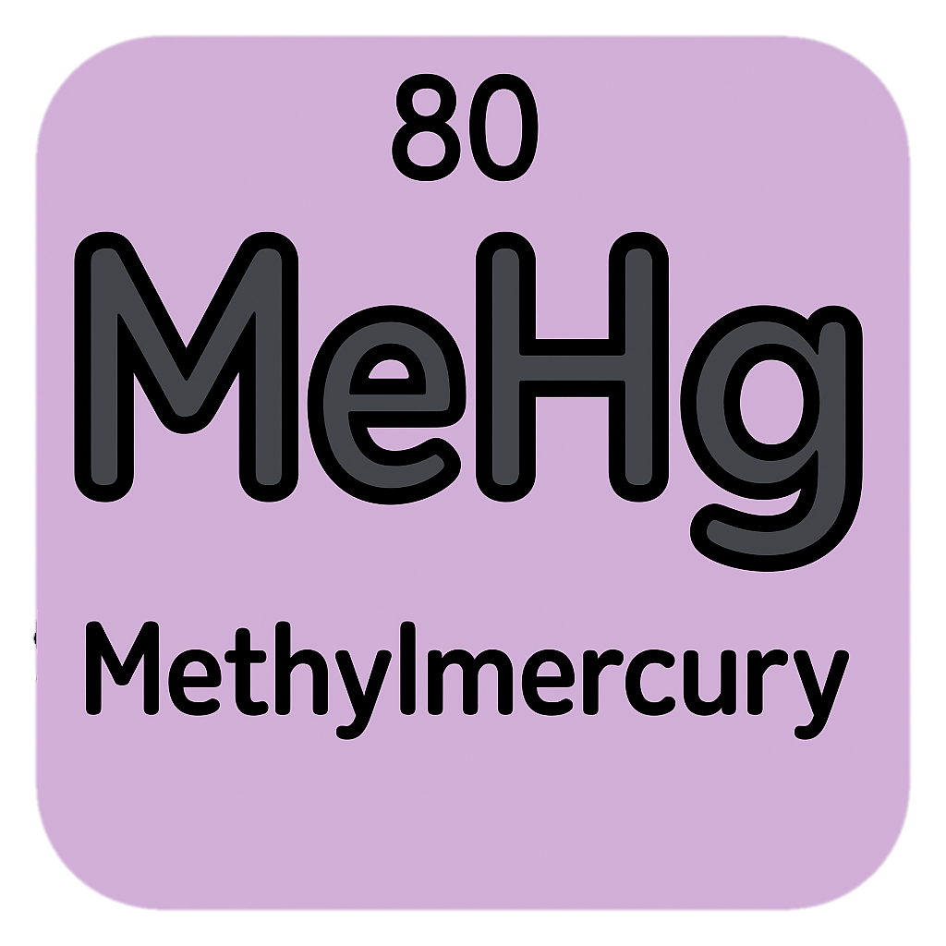

Slide 17
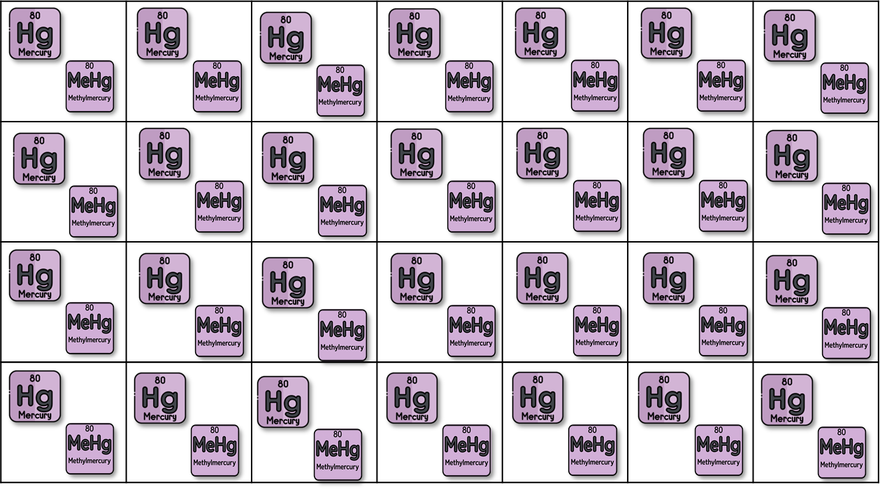
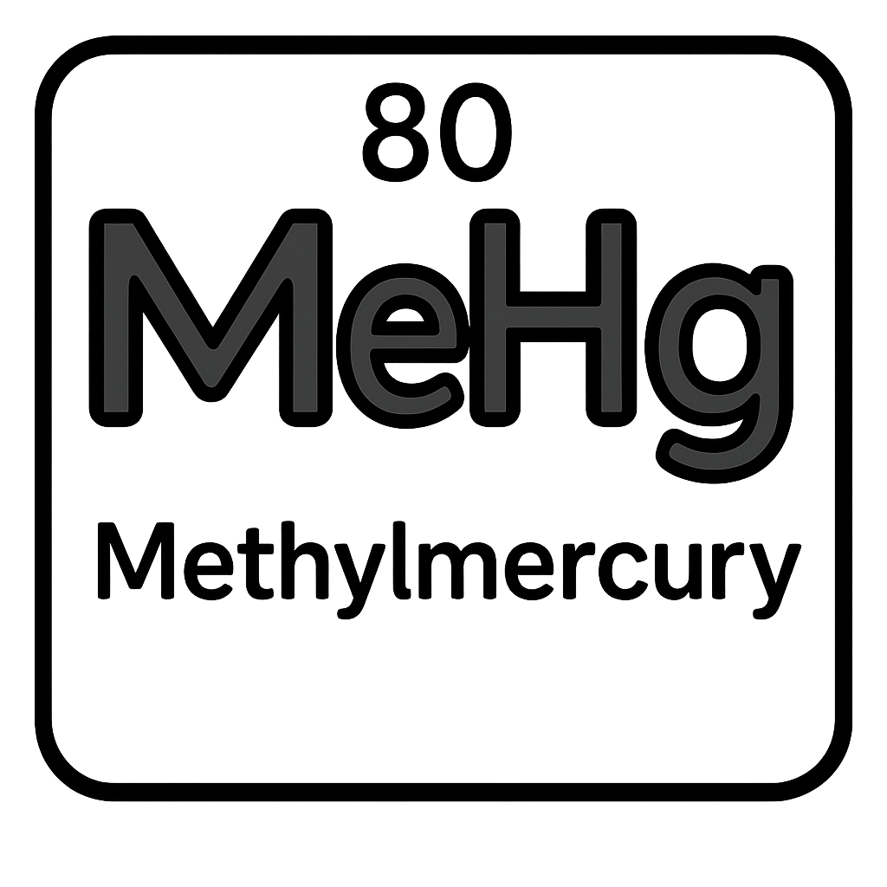
Hg-Exposure =
MeHg-Exposure =

Slide 18
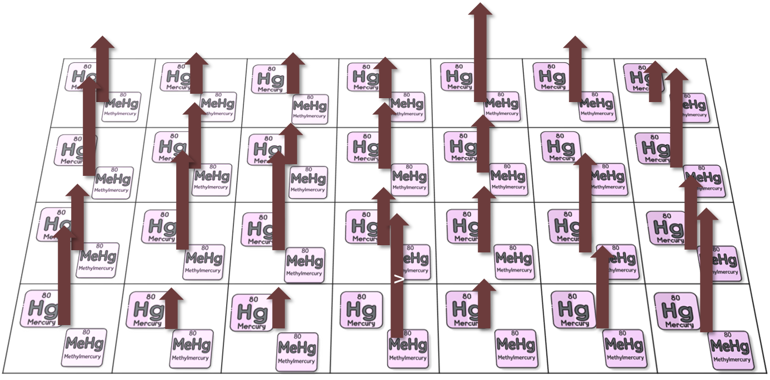

Slide 19
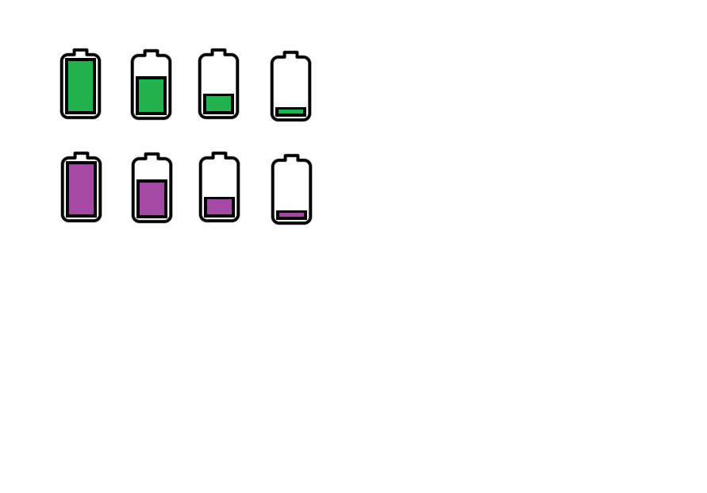
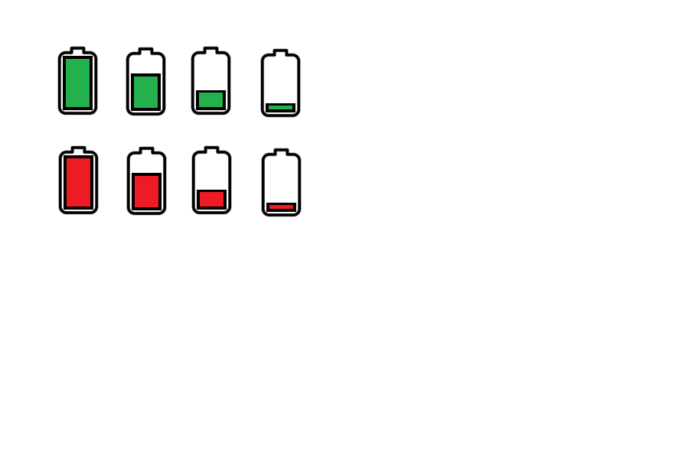

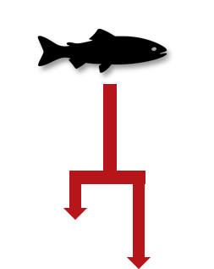
5. Fish Determine Bioaccumulation Risk
🧠
Contamination
Stress
SPM
Environmental Contamination
(Mercury and Methylmercury)

Slide 20
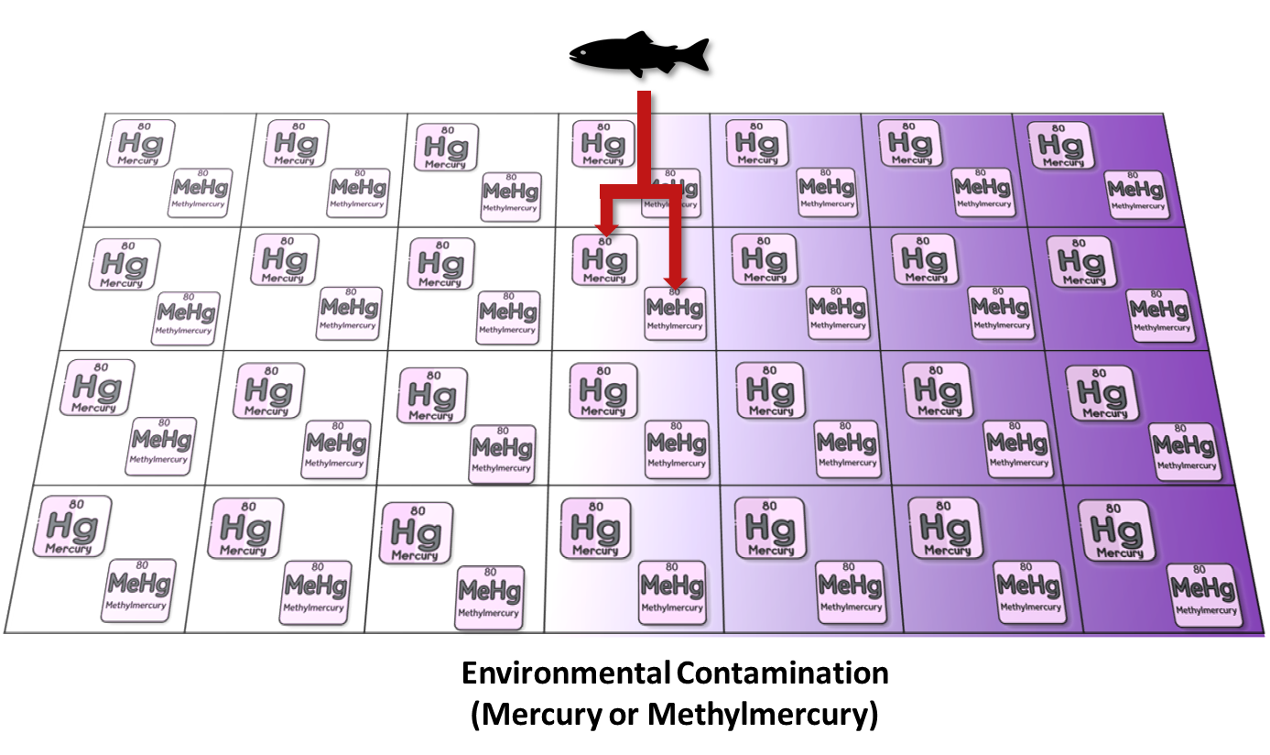
1. Fish Interact with Environmental Contamination
Fish Encounter Varying Levels of Contamination Throughout their Environment

Slide 21
Fish Interact with Environmental Contamination
Fish Encounter Varying Levels of Contamination Throughout their Environment
Individual Steps:
Track how much contamination fish is exposed to in each patch
Track cumulative contamination levels of exposure throughout migration
Determine bioaccumulation risk
Track total time fish spends exposed to contamination above toxic levels

Slide 22
Fish Interact with Environmental Contamination
Fish Encounter Varying Levels of Contamination Throughout their Environment
Environmental Steps:
Track how much time a fish spends in each patch
Track cumulative contamination levels of exposure throughout migration
Track total time fish spends exposed to contamination above toxic levels

Slide 23
1. Fish Interact with Environmental Contamination
Environmental Variables
Time-Spent = Time-Spent + 1
Hg-Exposure = Mercury Concentration in Patch
MeHg-Exposure = Methylmercury Concentration in Patch
Fish Encounter Varying Levels of Contamination Throughout their Environment

Slide 24
2. Track Time Fish Spends in Each Patch
Environmental Contamination
(Mercury or Methylmercury)
Time-Spent = Time-Spent + 1

Slide 25
1. Fish Interact with Environmental Contamination
Environmental Contamination
(Mercury or Methylmercury)
Fish Encounter Varying Levels of Contamination Throughout their Environment

Slide 26
2. Fish Track How Much Contamination They Encounter
Contamination Levels
Contamination Levels
Environmental Contamination
(Mercury or Methylmercury)

Slide 27
2. Fish Track How Much Contamination They Encounter
Contamination Levels
Contamination Levels
Environmental Contamination
(Mercury or Methylmercury)

Slide 28
2. Track How Much Contamination Fish Encounter
Environmental Contamination
Hg-Exposure = Mercury Concentration in Patch
MeHg-Exposure = Methylmercury Concentration in Patch
Notes:
Where exposure captures temporal changes in exposure to contamination throughout the migrations.

Slide 29
3. Track How Much Total Contamination Fish Encounter
Environmental Contamination
Hg-Exposure-Total = Hg-Exposure-Total + Hg-Exposure
MeHg-Exposure-Total = Hg-Exposure-Total + Hg-Exposure
Notes:
Where exposure captures temporal changes in exposure to contamination throughout the migrations.

Slide 30
4. Determine if Contamination Exceeds Recommended Health Threshold for Fish Exposure
Environmental Contamination
If Hg-Exposure > 15 ug/kg Hg-Exposure-Duration = Hg-Exposure-Duration + 1
If MeHg-Exposure > 150 ug/kg MeHg-Exposure-Duration = MeHg-Exposure-Duration + 1
Notes:
Where Exposure duration quantifies the amount of time fish spend in areas exceeding recommended toxicity thresholds by NOAA.

Slide 31
5. Track Amount of Time Fish is Exposed in Patch
Environmental Contamination
If Hg-Exposure > 15 ug/kg Hg-Patch-Exposure-Time = Hg-Patch-Exposure-Time + 1
If MeHg-Exposure > 150 ug/kg MeHg-Patch-Exposure-Time = MeHg-Patch-Exposure-Time + 1
Notes:
Where Exposure duration quantifies the amount of time fish spend in areas exceeding recommended toxicity thresholds by NOAA.

Slide 32
5. Determine Bioaccumulation Risk
Stress increases respiration leading to increased SPM exposure to gills for bioaccumulation.
Legend
SPM
Environmental Contamination & Suspended Particulate Matter (SPM)
Hg-Uptake-Risk = Hg-Exposure * Stress * SPM
MeHg-Uptake-Risk = MeHg-Exposure * Stress * SPM
Notes:
Uptake risk is related to the level of stress a fish is experience, the level of suspended material in their current patch, and the level of contamination in their current patch.
Transforms static mercury and methylmercury data to dynamic exposure with material transport.
This uptake risk tracks the instantaneous changes in bioaccumulation risk from spatial-temporal dynamics: what is occurring at this individual’s space and time contributing to bioaccumulation of mercury and methylmercury?

Slide 33
6. Track Location of Bioaccumulation Risk
Legend
SPM
Environmental Contamination & Suspended Particulate Matter (SPM)
Hg-Patch-Risk = Hg-Uptake-Risk
MeHg-Patch-Risk = MeHg-Uptake-Risk
Notes:
Uptake risk is related to the level of stress a fish is experience, the level of suspended material in their current patch, and the level of contamination in their current patch.
Transforms static mercury and methylmercury data to dynamic exposure with material transport.
This uptake risk tracks the instantaneous changes in bioaccumulation risk from spatial-temporal dynamics: what is occurring at this individual’s space and time contributing to bioaccumulation of mercury and methylmercury?

Slide 34

2. Fish Keep Track of Cumulative Contamination Throughout Migration
Contamination Levels
Contamination Levels
Contamination Levels
Legend
Contamination
Environmental Contamination

Slide 35
4. Patches Track the Amount of Time Spent and How Many Fish Use Each Patch
Exposure-Duration = 0
Exposure-Duration = 1
Legend
Time: 1
Time: 1
Contamination
Fish: 1
Fish: 1
Time: 1
Exposure-Duration = 2
Time: 1
Fish: 1
Fish: 1
Environmental Contamination
(Mercury and Methylmercury)

Slide 36
6. Patches Track Bioaccumulation Risk
Legend
Contamination
SPM
Risk: 1.4
Risk: 0.4
Environmental Contamination
(Mercury and Methylmercury)

Slide 37
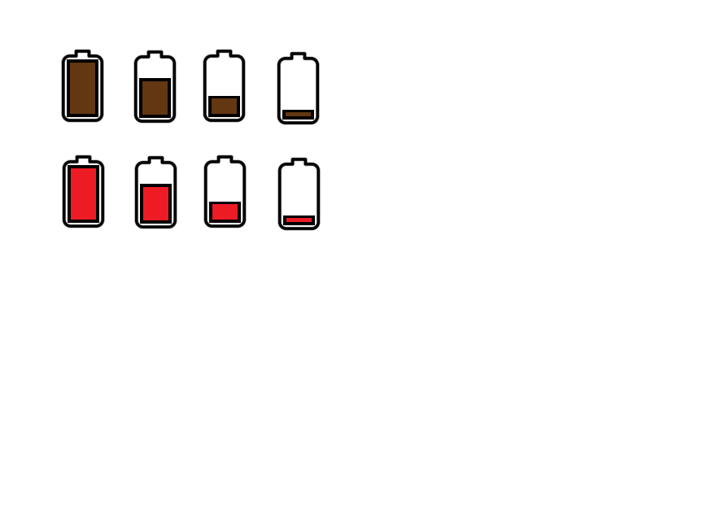
5. Fish Determine Bioaccumulation Risk
x
🧠
x
=
Contamination Levels
Stress
SPM
Bioaccumulation Risk
x
🧠
x
=
Contamination Levels
Stress
SPM
Bioaccumulation Risk

Slide 38

As fish migrate through contaminated areas, exposure accumulates over time, increasing overall contamination burden.
Exposure-Duration = 0
Exposure-Duration = 1
Legend
Contamination
SPM
Time: 1
Time: 1
Fish: 1
Fish: 1
Risk: 1.4
Risk: 0.3
Contamination Levels
Exposure-Duration = 2
Time: 1
Time: 1
Fish: 1
Fish: 1
Risk: 0.8
Environmental Contamination

Slide 39
Prolonged exposure to high contamination adds up over time, creating cumulative health risks for migrating fish.
Exposure-Duration = 0
Exposure-Duration = 1
Legend
Contamination
Each patch tracks how many fish visit and how long they stay.
SPM
Time: 1
Time: 1
Fish: 1
Fish: 1
Risk: 0.3
NOAA
Exposure-Duration = 2 + 0
Contamination Levels
Exposure-Duration = 2
Time: 1
Time: 1
Fish: 1
Fish: 1
Risk: 0.8
Environmental Contamination

Slide 40
Bioaccumulation risk varies by patch as fish encounter different combinations of contamination, stress, and suspended particles during migration.
Different environmental conditions across the migration path cause bioaccumulation risk to fluctuate from patch to patch.
Uptake-Risk = 1.4
Uptake-Risk = 0.3
Legend
Contamination
Each patch tracks how many fish visit and how long they stay.
SPM
Time: 1
Time: 1
Fish: 1
Fish: 1
=
Risk: 0.3
NOAA
SPM
Stress
Contamination
Uptake Risk
Uptake-Risk = 0.8
Time: 1
Time: 1
Fish: 1
Fish: 1
Risk: 1.5
Risk: 0.8
Environmental Contamination

